Slide 1
Angular Basic
Day 2
Nguyen Nhu Tuan
tnguyennhu@pentalog.com

Slide 2
Content
Build tool
Styling
Module
Component
Template
Routing
Dependency injection
Pipe
Form
JWT Authentication, Guard
HTTPClient
Unit test >>> Next time
E2E >>> Next time

Slide 3
Build tool
Npm
Yarn
Angular CLI
  JIT: Just-in-Time >>> ng serve
  AOT: Ahead-of-Time >>> ng build --aot
  https://angular.io/guide/aot-compiler

Slide 4
Styling
SCSS

Slide 5
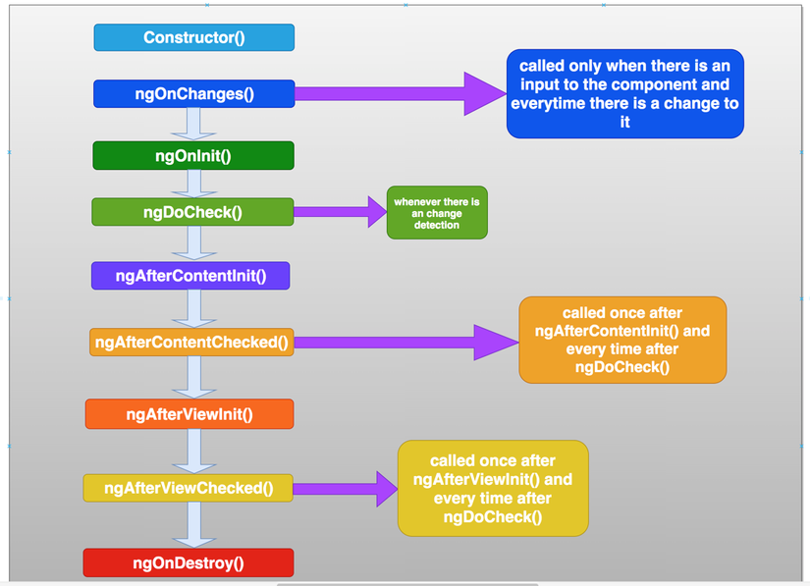
LifeCycle

Slide 6
Module
Declares which components, directives, and pipes belong to the module.
Makes some of those components, directives, and pipes public so that other module's component templates can use them.
Imports other modules with the components, directives, and pipes that components in the current module need.
Provides services that other application components can use.

Slide 7
Module
Bootstrap
  the root component that Angular creates and inserts into the index.html host web page.

Slide 8
Component

Slide 9
Component

Slide 10
Template
Property binding
  <p><img src="{{itemImageUrl}}"> is the <i>interpolated</i> image.</p>
  <p><img [src]="itemImageUrl"> is the <i>property bound</i> image.</p>

Slide 11
Template
Event binding
  <button (click)="onSave()">Save</button>
Custom event
  @Output() deleteRequest = new EventEmitter<Item>();
  // Do change value item
  this.deleteRequest.emit(this.item);
  <app-item-detail (deleteRequest)="deleteItem($event)" [item]="currentItem"></app-item-detail>

Slide 12
Template
Sharing data between child and parent directives and components
  @Input() item: string;
  <app-item-detail [item]="currentItem"></app-item-detail>
  @Output() deleteRequest = new EventEmitter<string>();
  // Do chaneg something here
  this.deleteRequest.emit(value);
  <app-input-output [item]="currentItem" (deleteRequest)="crossOffItem($event)"></app-input-output>

Slide 13
Template
Two way binding
  Two-way binding combines property binding with event binding:
    Property binding sets a specific element property.
    Event binding listens for an element change event.
  https://stackblitz.com/angular/kkgxanqyqnn?file=src%2Fapp%2Fsizer%2Fsizer.component.ts

Slide 14
Routing

Slide 15
Dependency injection
ForRoot >>> Next time
ForChild >>> Next time

Slide 16
Pipe

Slide 17
Form

Slide 18
JWT Authentication, Guard

Slide 19
HTTPClient

